Slide 1
Asynchronous Distributed ADMM for Consensus Optimization
Ruiliang Zhang
James T. Kwok
Department of Computer Science and Engineering, Hong Kong University of Science and Technology, Hong Kong

Slide 2
The Alternating Direction Method of Multipliers (ADMM)
Distributed Optimization and Statistical Learning via the Alternating Direction Method of Multipliers, Stephen Boyd, Neal Parikh, Eric Chu, Borja Peleato, and Jonathan Eckstein

Slide 3
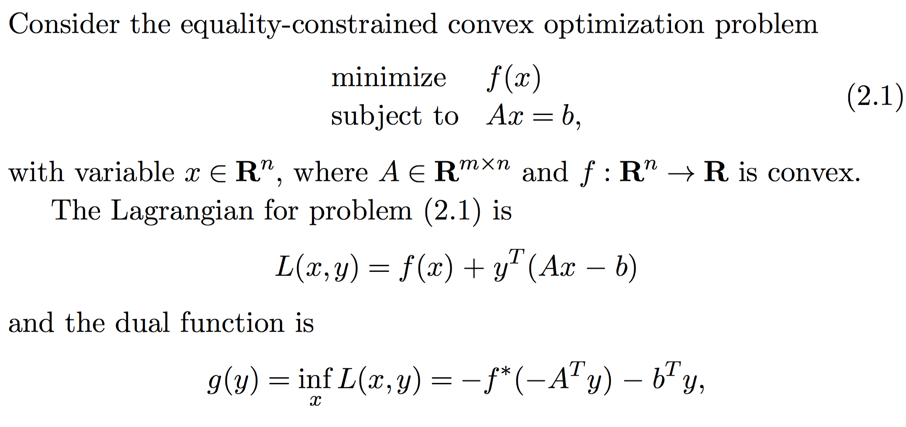
Dual Ascent (1/2)

Slide 4
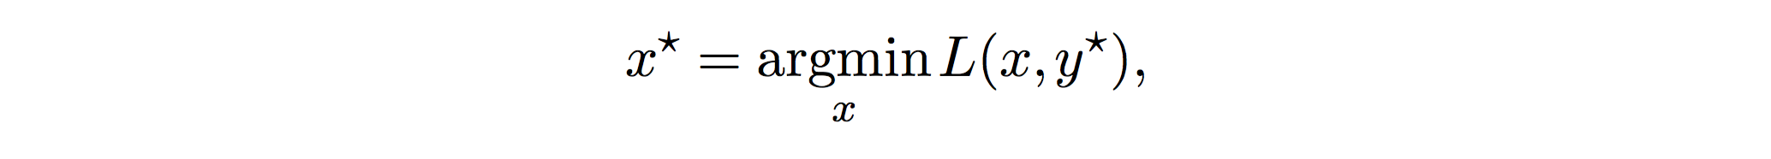
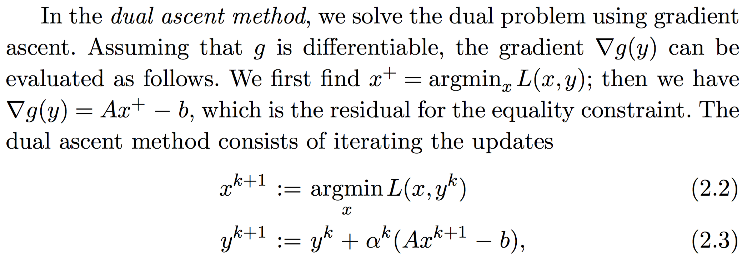
Dual Ascent (2/2)
If strong duality holds,

Slide 5
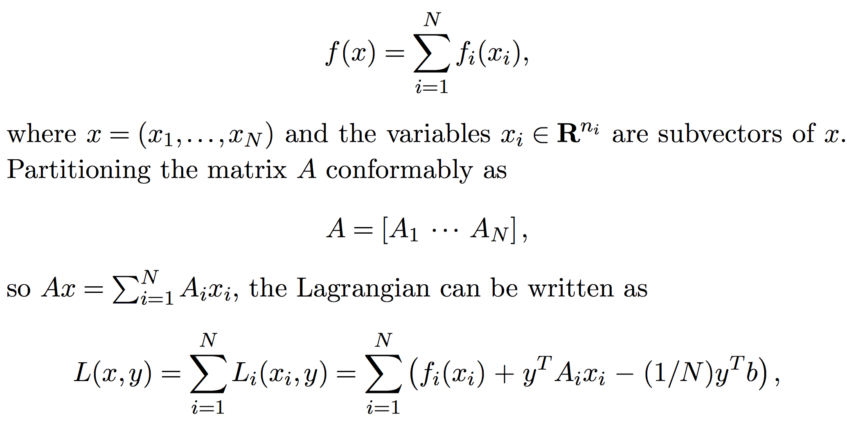
Large sum-separable objectives, block-wise constraints

Slide 6
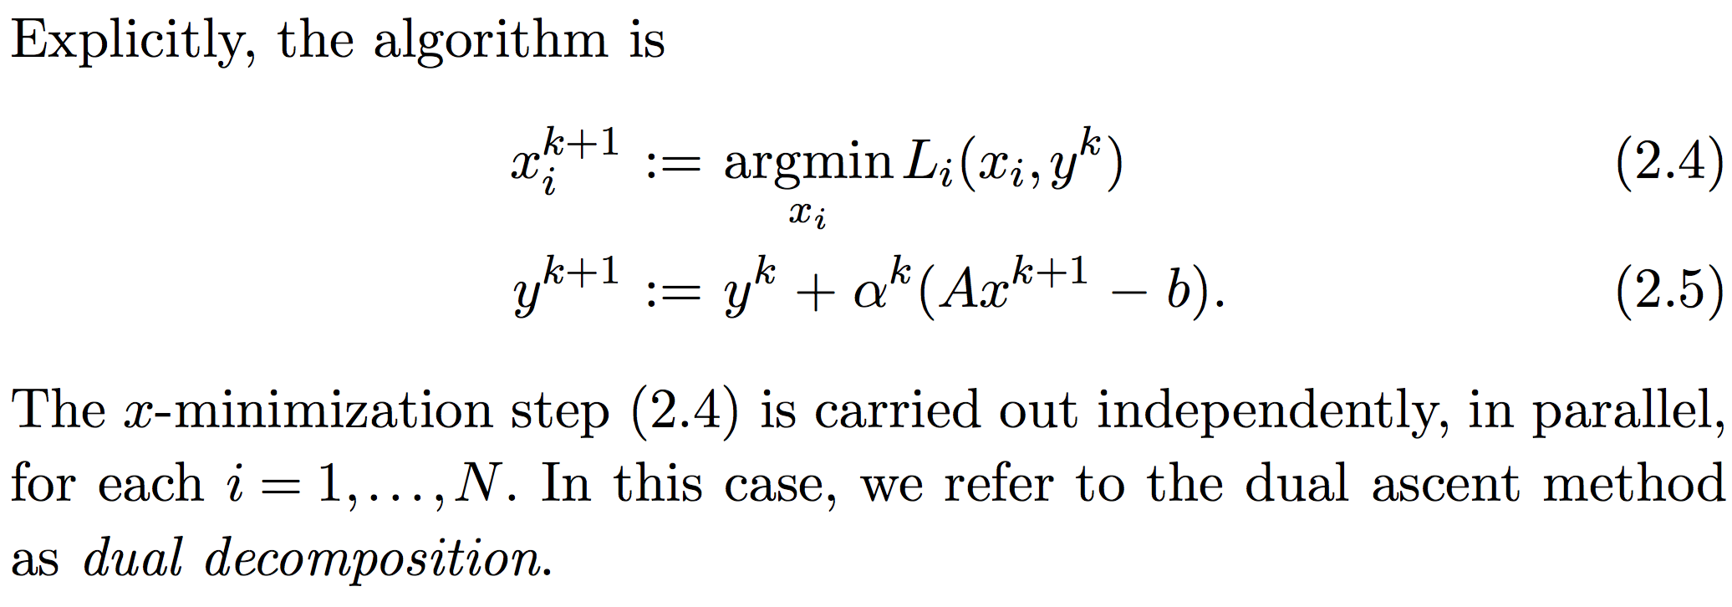
Dual ascent for scalable statistical learning

Slide 7
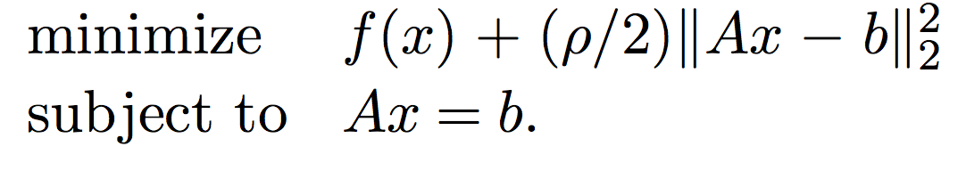
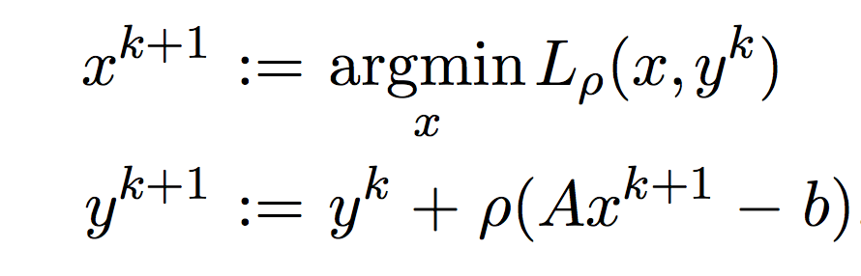
Augmented Lagrangian (for L1 penalizations)

Slide 8
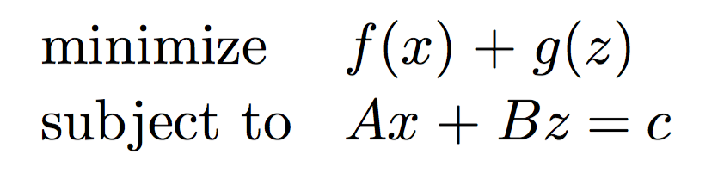
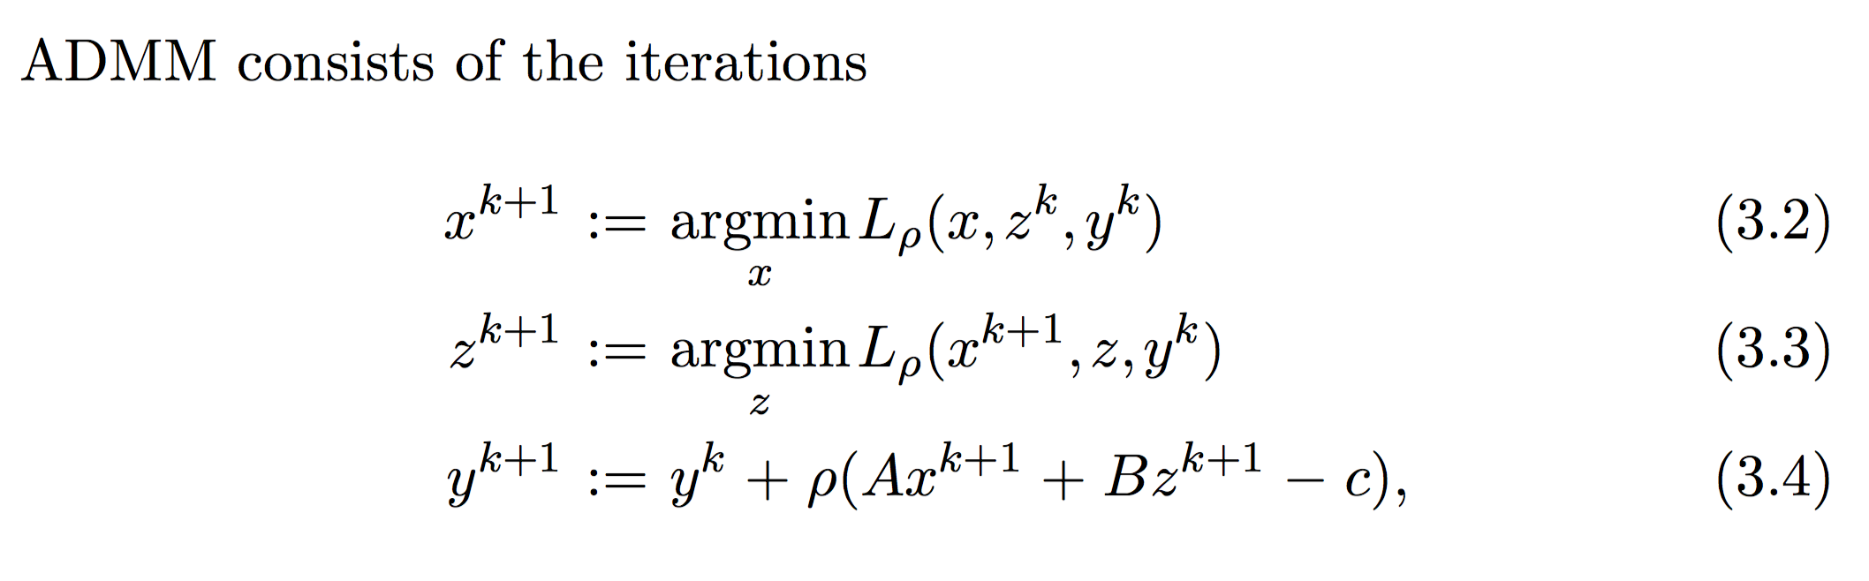
ADMM

Slide 9
ADMM with asynchronous updates
Asynchronous Distributed ADMM for Consensus Optimization, Ruiliang Zhang, James T. Kwok

Slide 10
Why do we care about asynchronous algorithms?
Stragglers are very common in data centers
Assume we have N machines
Only S are going to respond on time for the master to proceed with the consensus variable update
Three fundamental assumptions in this paper:
Bounded delay (tau)
Identical probability of straggling across slaves
Not all machines will be stragglers

Slide 11
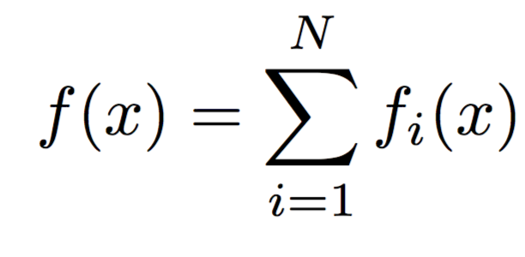
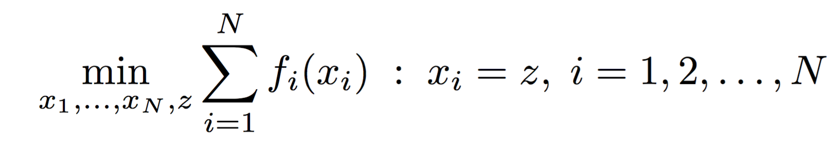
Distributed learning with a consensus variable

Slide 12
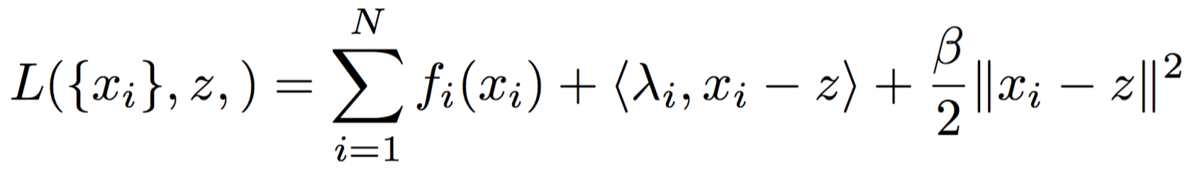
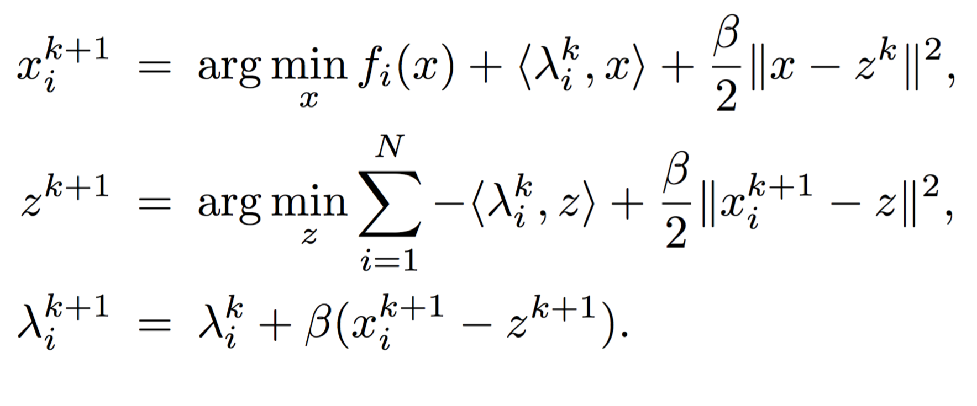
Instance of ADMM

Slide 13
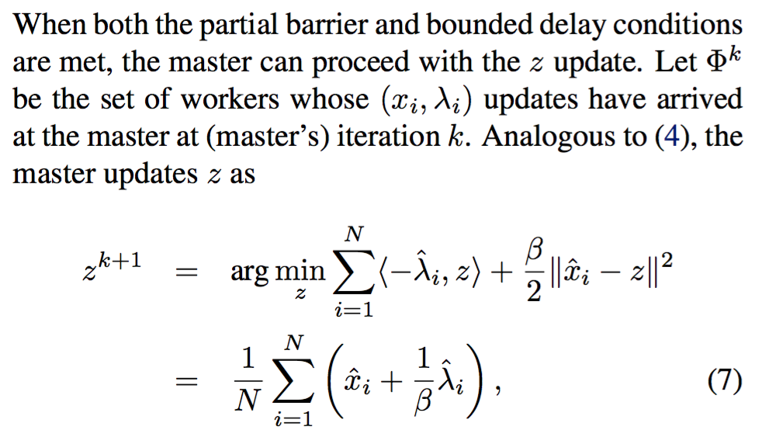
Asynchronous algorithm (1/2)
Master side:

Slide 14
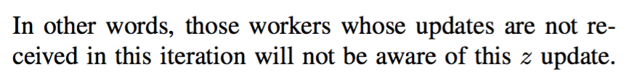
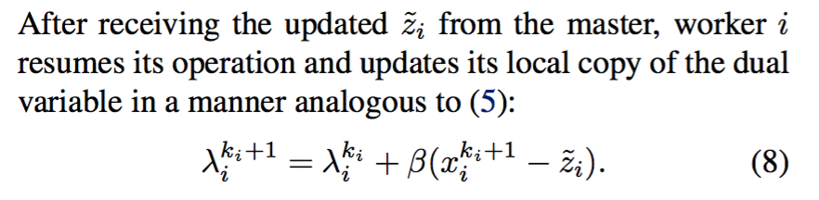
Asynchronous algorithm (2/2)
Slave side:

Slide 15
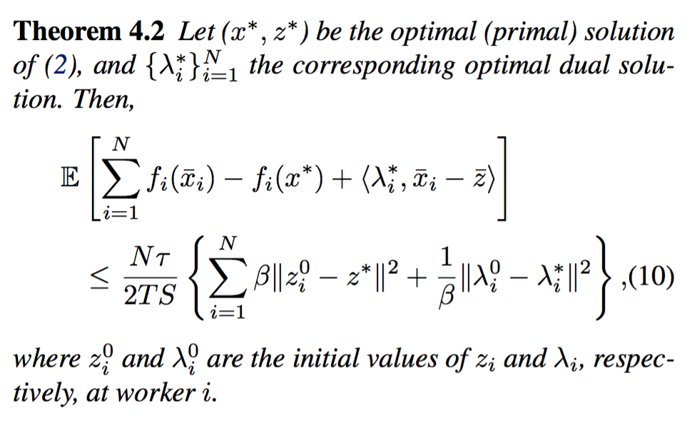
Convergence is identical to ADMM

Slide 16
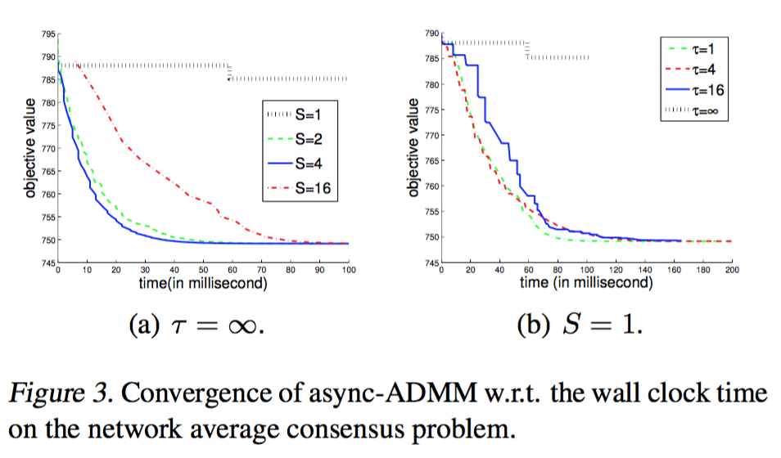
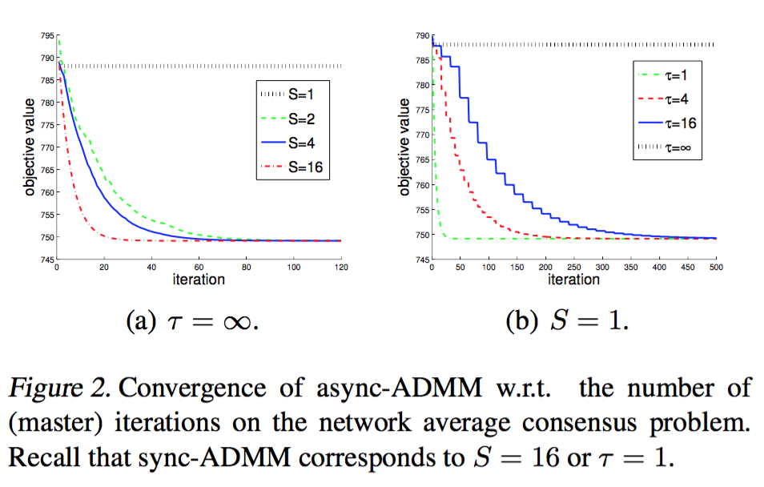
Computation times

Slide 17
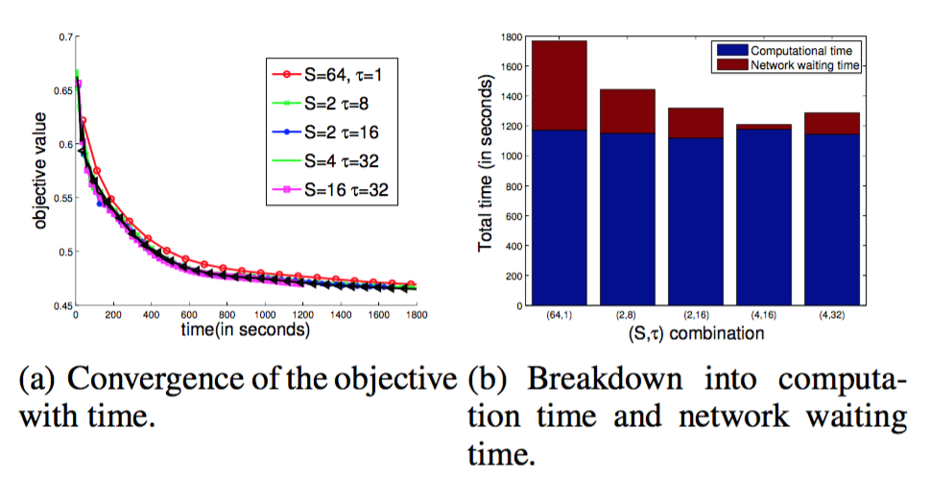
Communication efficiency

Slide 18
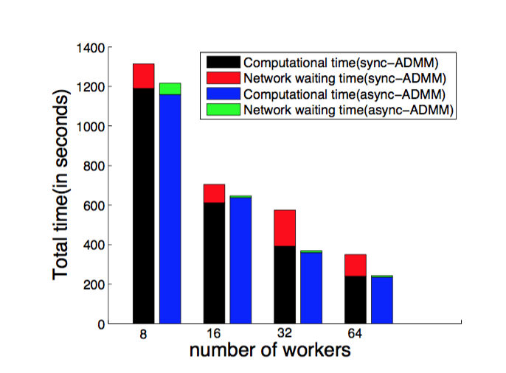
Scalability

